Slide 1


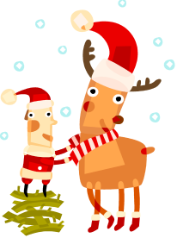





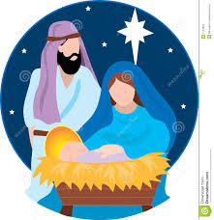

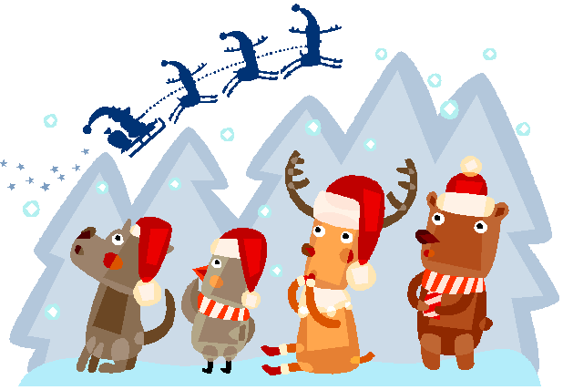
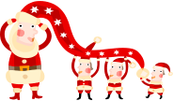












11
3
10
24
15
17
2
4
19
21
23
8
5
14
1
7
12
18
20
16
6
13
The Oaklands Way
22
9
Notes:
How To Use This Template:
Click the Slide Show button in the status bar to start the presentation. The calendar counts the first 25 days of December. Each day, click on the numbered button corresponding to the day of the month. Clicking on that button will reveal an image to you.
Advent Calendar Template Customization Instructions:
To add and format a background:
To add the background of a house scene, right-click the slide background, click Format Background.
In the Format Background dialog box, in the left pane click Fill, and in the right pane, select Picture or texture fill.
Under Insert from, click File, locate the picture that you want to use as the background, and then click Open.
Note: You may download free images from Microsoft Office Online (http://office.microsoft.com).
To replace the pictures (of elves and other characters in the windows and on the rooftop) with your own pictures, do the following:
On the Home tab, in the Editing group, click Select, and then click Selection Pane.
Note: It is easier to select pictures from within the Selection and Visibility pane than directly on the slide.
In the Selection and Visibility pane, click a reveal item (example: reveal_9)
Note: Each reveal item is associated with a picture. And each reveal item has a number, where each number matches the button that covers the picture. For example, the reveal_9 (picture) is located under button number 9)
After you have selected the reveal item associated with the picture that you want to replace, on the slide, locate and right-click the selected picture, and then click Format Picture.
In the Format Picture dialog box, in the left pane click Fill, and in the right pane, select Picture or texture fill.
Under Insert from, click File, locate the picture that you want to place on the calendar, and then click Open.
To reproduce the button and reveal shapes and images on this slide, do the following:
On the Home tab, in the Drawing group, click Shapes.
Select a “reveal” shape (such as a rectangle to cover a window, or a star in the sky), and then click and drag to draw the shape on the slide.
Fill these shapes with pictures or clip art images. (see procedures above)
On the Selection and Visibility pane, double-click on the [object] to edit the text and type a new name (“reveal_1”).
Next, on the Home tab, in the Drawing group, click Shapes.
Select a “button” shape, and then click and drag to draw the shape on the slide. (For example, a rectangle is drawn over the first window and it is now button #1).
Right-click on the “button” shape and select Edit Text. Type in the text (number) for that “button.”
On the Selection and Visibility pane, double-click on the [object] to edit the text and type a new name (“button_1”).
Position the “button” shape on this slide so that it completely covers the “reveal” shape.
To reproduce the animation effects on the slide, do the following:
On the Animations tab, in the Animations group, click Custom Animation. The Custom Animation pane opens up.
To assign an effect to the “button” (in this case Fade), select the button on the slide, and then in the Custom Animation pane, click Add Effect, point to Exit, click More Effects. In the Add Exit Effect dialog box, under Subtle click Fade.
Also in the Custom Animation pane, click the arrow to the right of the effect that you just added (fade exit effect) and select Timing. In the Fade dialog box, on the Timing tab, do the following:
Click the double arrows to the right of Triggers.
Click Start effect on click of.
Next to Start effect on click of, in the list select the “button” shape.
On the slide, select the picture-filled (“reveal”) shape beneath the “button” shape, and in the Custom Animation pane, click Add Effect, point to Entrance, and click More Effects. In the Add Entrance Effect dialog box, under Subtle, click Fade.
Also in the Custom Animation pane, select the effect that you just added (fade entrance effect), and then under Modify: Fade, in the Start list select With Previous.
Follow the same procedures with the remaining 24 “button” and “reveal” pairs of objects on the slide.

Slide 2



1st December
Isaiah 7:14
"Therefore the Lord Himself will give you a sign: Behold, a virgin will be with child and bear a son, and she will call His name Immanuel.
Today; Be positive, look around; is there someone who needs help, can you help someone today?
Make someone’s day by paying attention to people around you.

Slide 3

4th December
“It is the beautiful task of Advent to awaken in all of us memories of goodness and thus to open doors of hope.“ Joseph Cardinal Ratzinger
· · Open the door for your teacher or a friend who is struggling with their bags, or do it anyway
just to be kind.

Slide 4


5th December
“At this Christmas when Christ comes, will He find a warm heart? Mark the season of Advent by loving and serving the others with God's own love and concern.”
― Mother Teresa,
Carry out a random act of kindness today.
Think about how you can make someone’s day a little bit brighter and happier.
“:

Slide 5

6th December
You are rewarded not according to your work or your time but according to the measure of your love”. St. Catherine of Siena
· Pay a compliment to the person sitting next to you and continue giving compliments to people in our school; Look for positives in everyone.

Slide 6
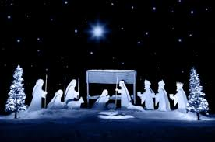
7th December
“Silence is so lacking in this world which is often too noisy, which is not favourable to recollection and listening to the voice of God," Pope Benedict XVI
· · · Take time to listen to your friends and family. Ask them how they are and take an interest in what they are saying.
.

Slide 7
8th December
“Silence is so lacking in this world which is often too noisy, which is not favourable to recollection and listening to the voice of God," Pope Benedict XVI
· · · Take time to listen to your friends and family. Ask them how they are and take an interest in what they are saying.
.

Slide 8

11th December
If God is the centre of your life, no words are necessary. Your mere presence will touch hearts. Vincent de Paul
Today after school, call your grandparents or Godparents, or someone else you haven’t spoken to for a while, and ask them how they are doing.

Slide 9

12th December
"Joy is the true gift of Christmas, not the expensive gifts that call for time and money. We can communicate this joy simply: with a smile, a kind gesture, a little help, forgiveness. And the joy we give will certainly come back to us“ Pope Benedict XVI
Help out your parents/ carers today. Ask if you can help around the house or maybe make them a cup of tea or make them a Christmas card.

Slide 10

13th December
We become what we love and who we love shapes what we become. Clare of Assisi
· Help a classmate who may be struggling with his/her homework. Offer to help them understand what they need to do.

Slide 11

14th December
“…A voice cries in the wilderness: Prepare a way for the Lord…”
Mark 1:3
· · Light a candle for a relative or a friend. Write a prayer to say tonight before you go to sleep.

Slide 12

15th December
This weekend, take part in Christmas cleaning in your house. Suggest what you could do without parents having
to ask for help.

Slide 13

18th December
“Blessed is she who believed that the promise made her by the Lord would be fulfilled…”
Luke 1:45
Listen to a Christmas song or watch a Christmas film together with friends or family.

Slide 14
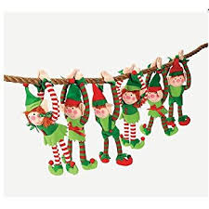
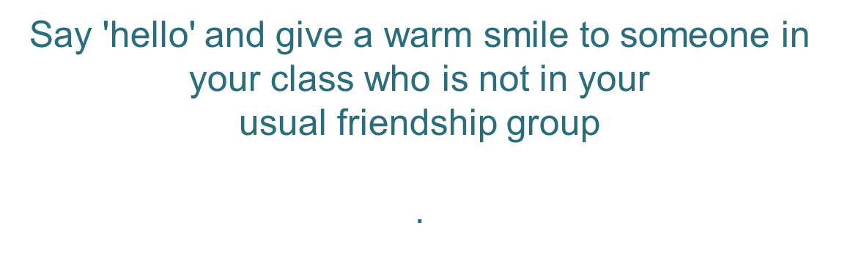
19th December
Beautiful is the moment in which we understand that we are no more than an instrument of God
Oscar Romero
.

Slide 15
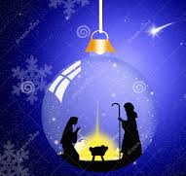
20th December
“Every time you smile at someone, it is an action of love, a gift to that person, a beautiful thing.”
― Mother Teresa
· Tell someone in your family that you love them. You can do this with words, a smile or a hug.

